Slide 1


An Overlooked Societal Health Crisis - Gun Violence
CMPE 256, Fall 2022
Presented by,
Team Petabyte Miners
Chaitra Bemgaluru Vishweshwaraiah
Wesley Shih
Kancheti Sai Pragna

Slide 2

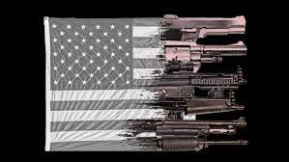
Gun Violence In USA

Slide 3

Gun Violence In USA
Gun violence is a preventable public health tragedy affecting communities all over the United States. Every day, more than 100 Americans die by gun violence, including 64 who die by firearm suicide, 39 Americans who die by firearm homicide, and 3 who are killed by other forms of gun violence.
In 2019, the most recent year of data available, there were 39,707 gun deaths – 109 every single day.4 Three in every five gun deaths are suicides and more than one-third are homicides, while the remainder are unintentional, of unknown intent, or law enforcement intervention.
Among high-income countries, the United States is an outlier in terms of gun violence. It has been well-documented that firearm ownership rates* are associated with increased firearm-related death rates.
The U.S. has the highest firearm ownership and highest firearm death rates of 27 high-income countries.5 The firearm homicide rate in the U.S. is nearly 25 times higher than other high-income countries and the firearm suicide rate is nearly 10 times that of other high-income countries

Slide 4
Gun Violence In USA
It is a common misconception that individuals living with mental illness are responsible for gun violence. When compared to other countries, the United States has similar rates of mental illness, yet we have much higher rates of gun violence.
To be clear, mental illness does not cause gun violence – the problem is access to firearms.
The debate over U.S. gun laws has raged for decades, often reigniting after high-profile mass shootings. Gun violence has surged amid the COVID-19 pandemic.
Gun ownership and gun homicide rates are high in the United States in comparison to rates in other advanced democracies. Mass shootings in Australia, Canada, and the United Kingdom prompted those governments to tighten gun laws.
Gun ownership in the United States is rooted in the Second Amendment of the Constitution: “A well-regulated Militia, being necessary to the security of a free State, the right of the people to keep and bear Arms, shall not be infringed.”

Slide 5
Gun Violence In USA
Federal law provides the basis for firearms regulation in the United States, but states and cities can impose further restrictions
Some studies have indicated that states with more restrictive gun laws, such as California or Hawaii, have lower incidences of gun deaths, although researchers say more analysis is needed.
In recent years, Congress has debated changes to existing gun laws, typically in the immediate aftermath of a high-profile mass shooting, such as that in Las Vegas in 2017 (sixty people killed), or in Parkland, Florida, in 2018 (seventeen killed)
Meanwhile, gun violence has surged amid the COVID-19 pandemic. As of June 2022, guns have killed some nineteen thousand people in the United States this year.
The majority of those were in acts of suicide. Mass shootings—those with at least four victims—were occurring at a rate of at least one per day

Slide 6
Problem Statement
This project aims to analyze, evaluate the gun violence data in the US for the year 2013 to 2018 and also to predict the number of injuries and death in future month-wise.

Slide 7
Knowledge Discovery In Databases(KDD)

Slide 8
KDD Process
Finding relevant knowledge from a set of data is known as knowledge discovery in databases (KDD).
This popular data mining method involves a number of steps, including data selection and preparation, data cleansing, the incorporation of prior information about the data sets, and the interpretation of precise answers from the observed results.
This process has 8 steps like data understanding, data cleaning, data integration, data selection, data transformation,data mining, pattern evaluation, and knowledge representation

Slide 9

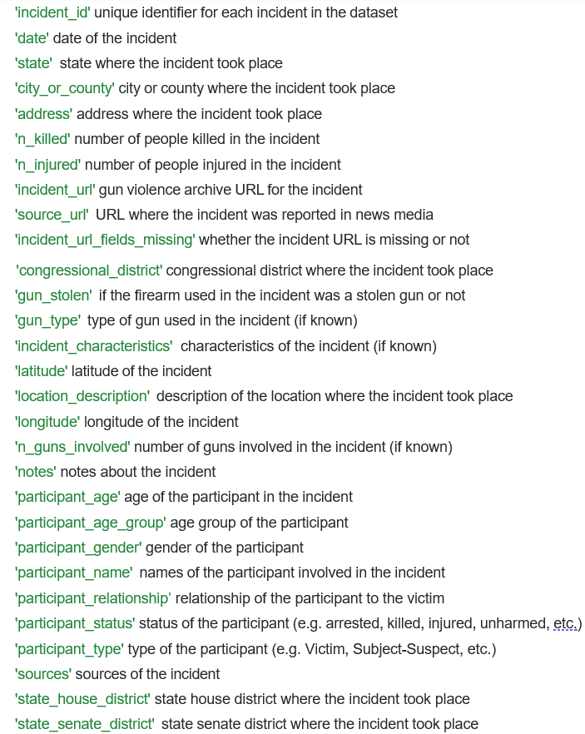
KDD Process
Data Understanding:
We have to study each column and understand what each represents. For each column, we have given a detailed description.
With a better understanding of each column, we can answer what went down in each incident, where did each incident took place, how it transpired (with what gun was involved and the characteristics of the incident), when did each incident occurred, and lastly why did the incident happened (with column ‘notes’ and source_url).
The spatial geographic information that is included in the data set can help us plot each incident on a map. And from there, we can find the patterns in the data and work on a potential clustering model.
The dataset has the columns as shown in the image

Slide 10
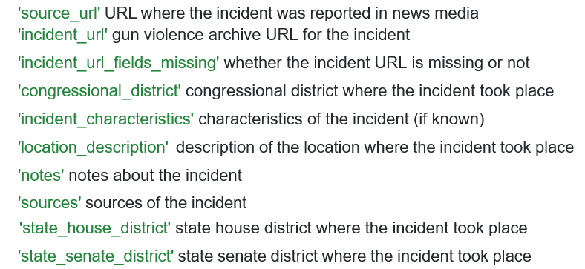
KDD Process
Data Selection:
The process of choosing and obtaining information from the data collection that is pertinent to the analysis is known as data selection.
With a better understanding of the dataset, we now can delete certain columns from our dataset before we do data cleansing. We are removing the columns shown in the image
We determined that the above columns do not add value to our analysis and keeping it would increase runtime when we are manipulating our dataset

Slide 11
KDD Process
Data Cleansing:
Data cleaning is the process of removing erroneous and unnecessary information from a collection.
We have cleaned up the values that are not needed in the dataset.
We also removed unnecessary columns as explained above.

Slide 12
KDD Process
Data Integration:
Data integration refers to the process of combining heterogeneous data from different sources into a single source (DataWarehouse).
Utilizing data migration technologies for data integration.
Using techniques for data synchronization for data integration.
Data integration using the ETL (Extract-Load-Transformation) method

Slide 13
KDD Process
Data transformation:
The process of changing data into the right form needed by mining procedures is referred to as data transformation.
Data transformation involves two steps:
Data mapping : This involves assigning components from a source base to a destination base in order to record transformations.
Code generation: Development of the transformation program itself.
For the values in Participant related columns, we did some transformation. After the transformation, we were able to use those columns more effectively.

Slide 14
KDD Process
Data Mining:
Data mining is the application of smart techniques to identify potentially relevant trends.
Creates patterns from task-relevant data.
Uses characterisation or classification to determine the model's purpose.

Slide 15
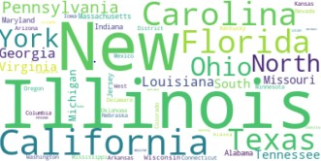
KDD Process – Data Mining Word Cloud of all states in US

Slide 16
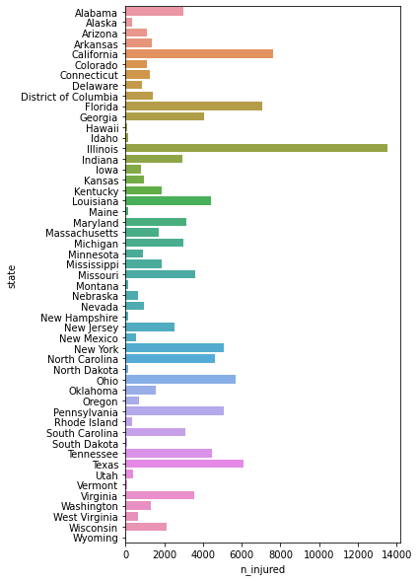
KDD Process – Data Mining
Number of people injured state-wise

Slide 17
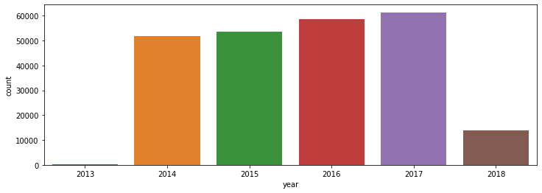
KDD Process – Data Mining
Number of incidents every year

Slide 18
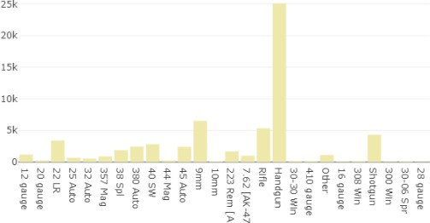
KDD Process – Data Mining
Types of Guns Used

Slide 19
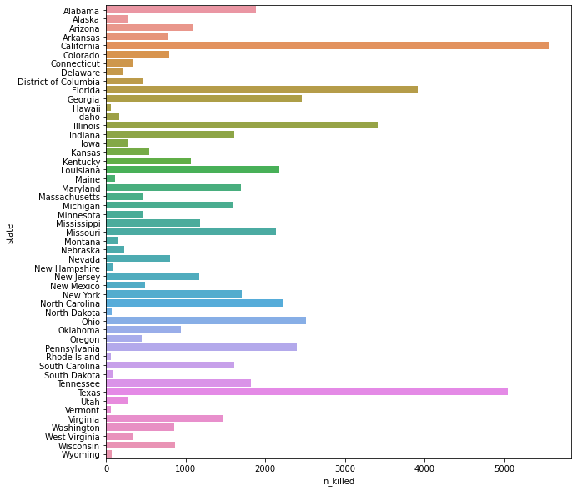
KDD Process – Data Mining
Number of people killed state-wise

Slide 20
KDD Process
Pattern evaluation:
Based on predetermined metrics, evaluation of patterns is described as the identification of strictly increasing patterns that indicate knowledge.
Uses summarization and visualization to make data user-friendly.

Slide 21
KDD Process
Knowledge Representation:
A strategy for representing the findings of data mining using visualization tools is known as knowledge representation.
Generate reports. Produce tables.
Make rules that discriminate, rules that classify, rules that characterize, etc.

Slide 22
Data Science Algorithms & Features Used
ARIMA :
It is a combo of Auto regression and Moving Average models.
To combine these two models, we have a different preprocessing step to make the sequence stationary, which is the I in ARIMA.
For time series work, there is a common assumption that the data are stationary. Stationary means that the property of the mean, variance autocorrelation structure does not change over time.
Non stationary is when the data has a strong trend (up/down). We believe that there should be a strong trend (non stationary) )of gun violence over the years of data, therefore using ARIMA model would be best to forecast future gun violence events.

Slide 23
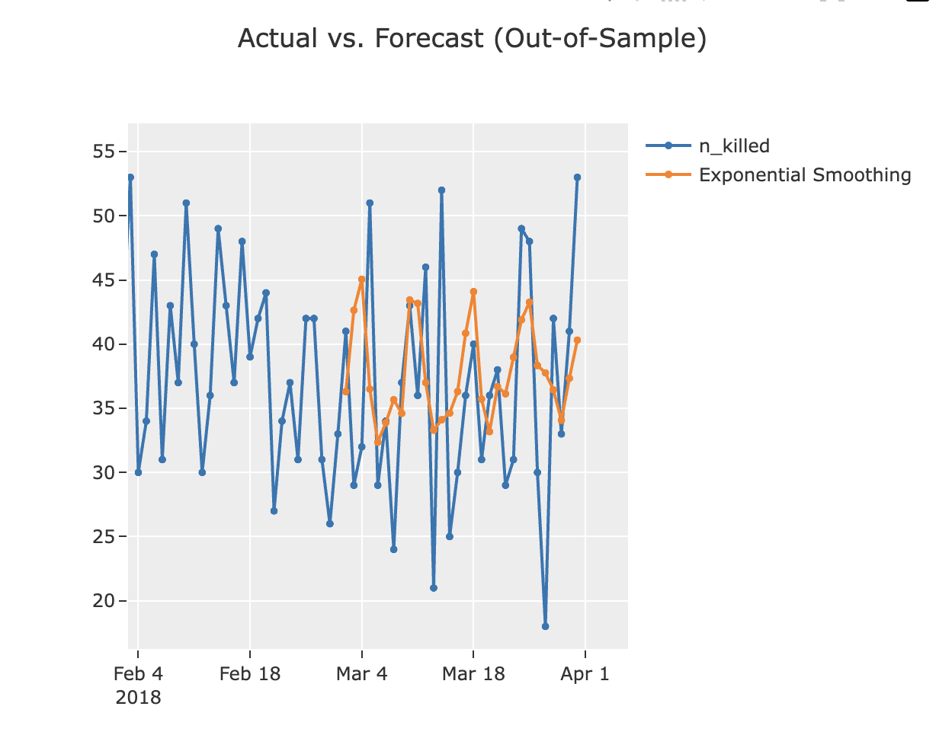
Data Science Algorithms & Features Used
Making the ARIMA model:
Once we are able to determine these 3 values, we can use them in our ARIMA method.
Then, we can use this model to do some predictions

Slide 24
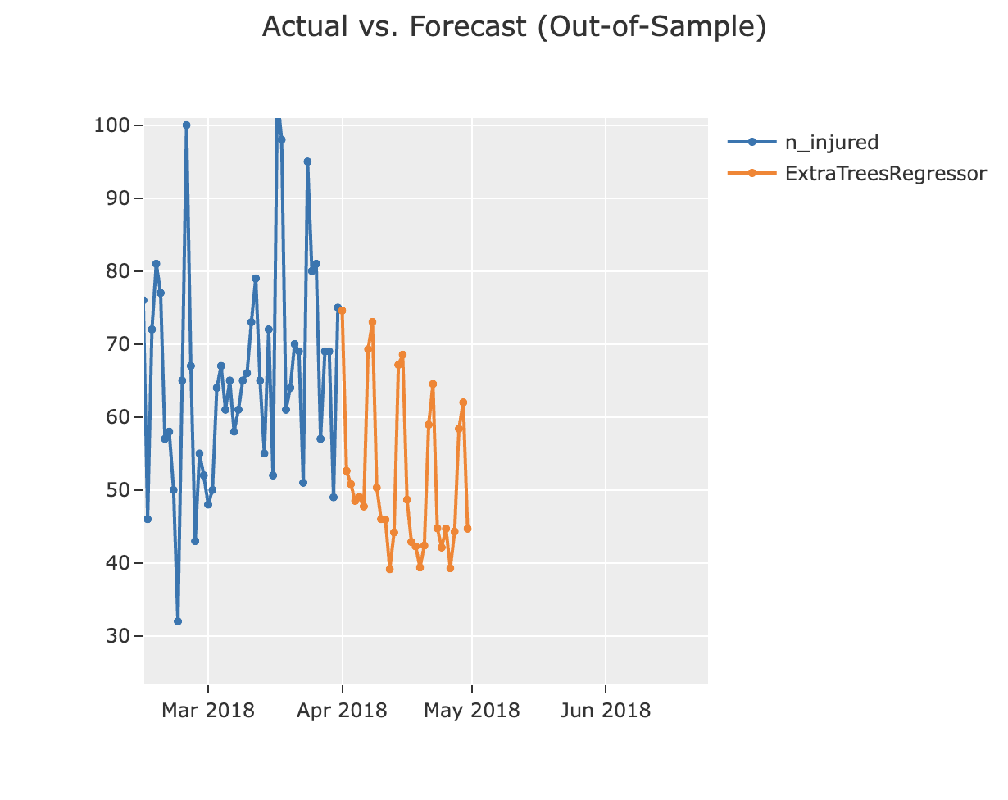
Data Science Algorithms & Features Used

Slide 25
Thank You

